Slide 1
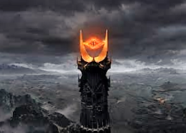
HOW THE COURT SEES NEW TECHNOLOGY

Slide 2
California v. Federal
California is Kelly+
Federal is a Daubert/Kumho
Federal Rules of Evid. 702
Daubert v. Merrell Dow Pharmaceuticals (1993) 509 U.S. 579
Kumho Tire Co. Ltd v. Carmichael (1999) 526 U.S. 137
Notes:
Fyre has technically been overruled Daubert, however Cal Supremes have conflagrated it into a Kelly rule.

Slide 3
The Basics for California
As a threshold issue, the court must determine if the methodology of the scientific testing is in fact “new?”
Kelly/Frye hearing is not required for new devices; it applies to new methodologies.
Cases:
People v. Kelly (1976) 17 C.3d 24
Frye v. United States (1923) 54 App.D.C. 46, 293 F. 1013

Slide 4
So how does it work in California?
First there has to be a scientific test or methodology that is relevant to an issue in the case.
Then, one of the parties need to object to it based on foundation; i.e. reliability and acceptability.
The Court then holds a hearing pursuant to Evidence Code section 402.
Court makes a finding that the methodology either does or does not meet the test for admissibility.
If so, it is presented to the jury.
Opposing Party can still attack it on its merits.

Slide 5
What is the California test?
Is this actually new?
Threshold issue.
Hearing can end right here
People v. Bury (1996) 41 Cal.App.4th 1194 – the PAS case
If it is new, it is a 3 prong test:
The reliability of the method must be generally accepted by recognized authorities in the scientific field in which the test belongs.
A witness giving expert testimony must be qualified as an expert on the subject.
It must be shown that correct scientific procedures were used in administering the method.

Slide 6
The reliability of the method must be generally accepted by recognized authorities in the scientific field in which the test belongs.
Court takes judicial notice of case law, other state statutory schemes and peer reviewed articles from scientific journals, or similar publications
See People v. Leahy (1994) 8 Cal.4th 587, 611-612.
Included in that judicial notice should be those studies that suggest the possibility of error in the tests or experiments.
The goal is to present a consensus drawn from the widest cross-section of the relevant, qualified scientific community.
People v. Reilly (1987) 196 Cal.App.3d 1127, 1148

Slide 7
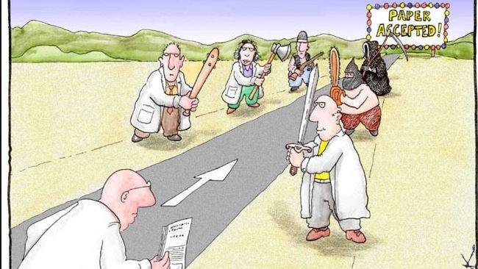

Slide 8
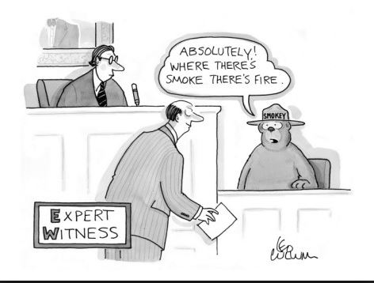
A witness giving expert testimony must be qualified as an expert on the subject.
Truth is, almost anyone can qualify as an expert if the proper foundation can be laid out by the attorney.

Slide 9
It must be shown that correct scientific procedures were used in administering the method.
The administration of the test must match the science –
Think blood draw -
Must be done in a medically approved fashion
Must be preserved
Must be tested in a Title 17 Laboratory
Here is where the testing methodology comes in

Slide 10
Questions?

Slide 11
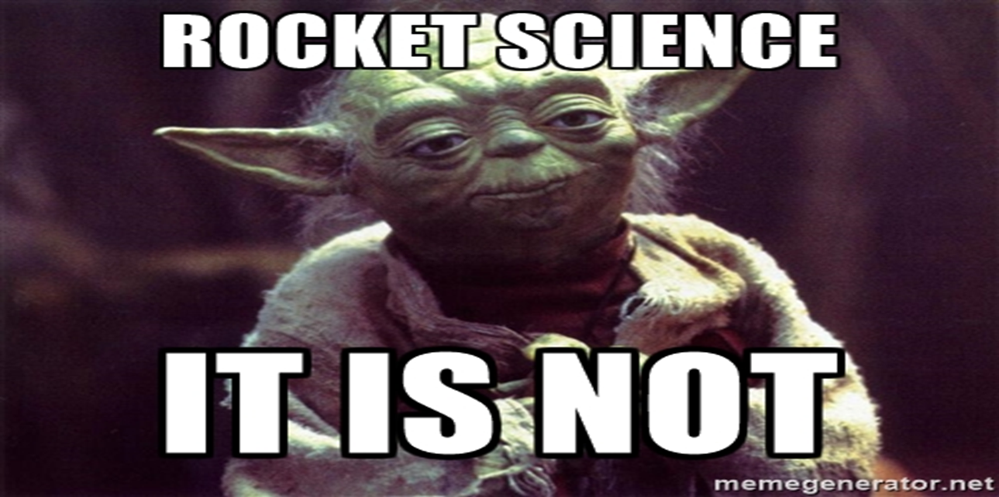
Need Help?
Michael J. Yraceburn
Supervising Deputy District Attorney
Kern County District Attorney
myraceburn@KernDA.org
(O) 661-868-2321
(C) 661-699-3168

